Slide 1

Mad Props
Brett Krokoff, Robert Tognoni, Noah Platt
01

Slide 2

Milestones (1-3)
Milestone 1 (4/23/22) Home Page and User Registration
Milestone 2 (4/25/22) User Login
Milestone 3 (4/27/22) Seller Dashboard

Slide 3
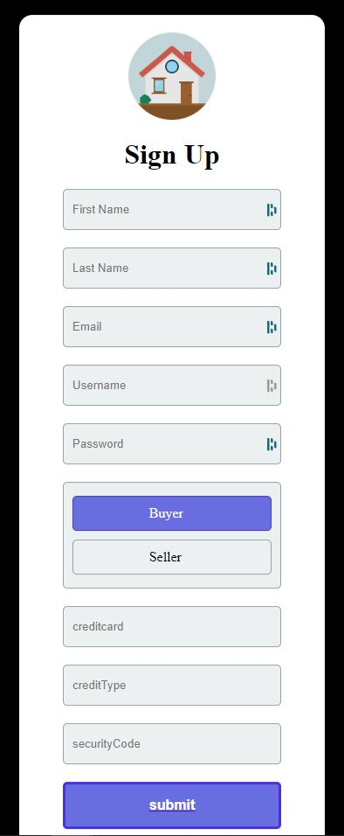
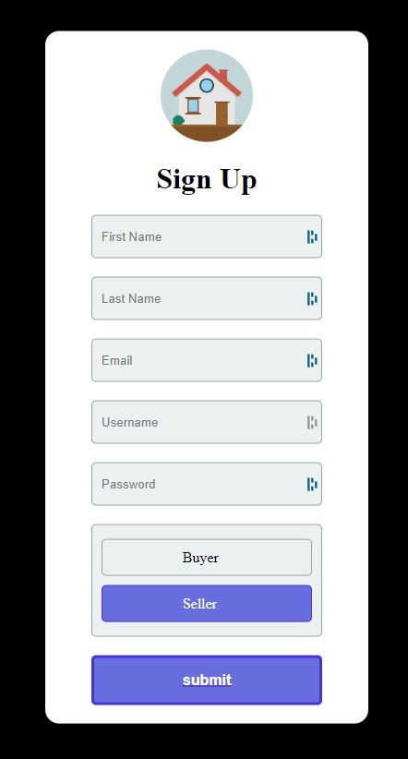
Milestone 1
Home Page and User Registration

Slide 4
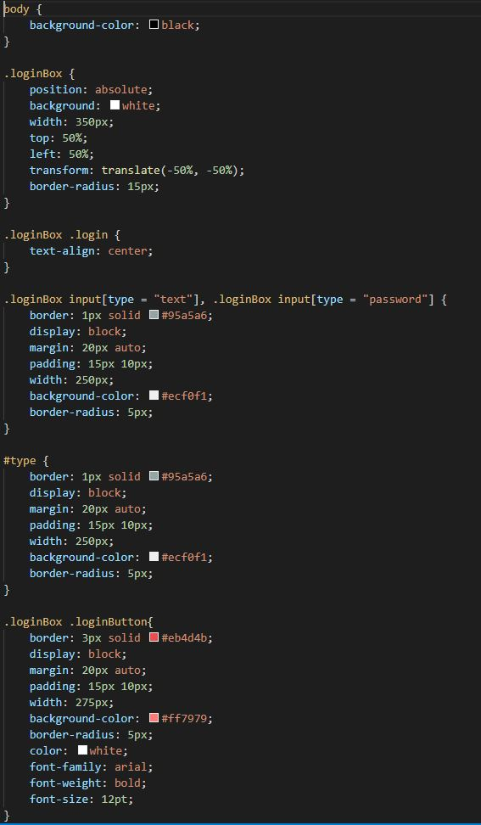
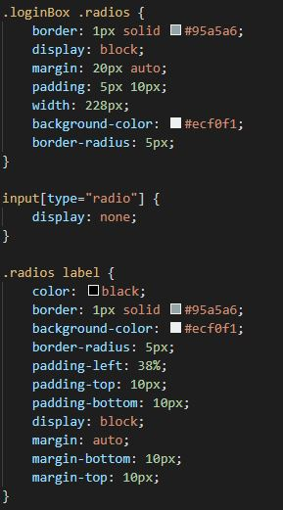

Slide 5
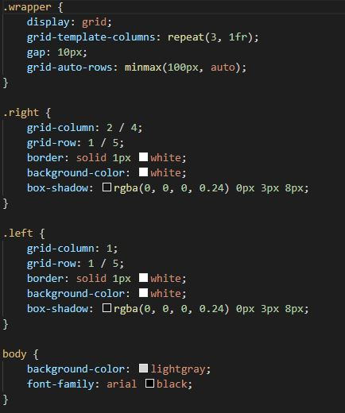
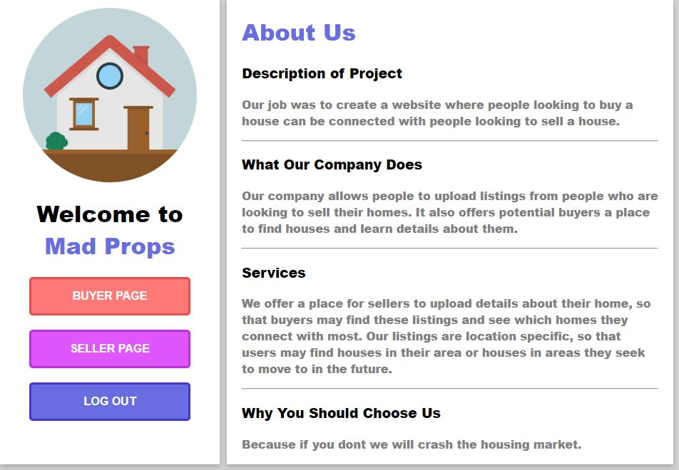

Slide 6
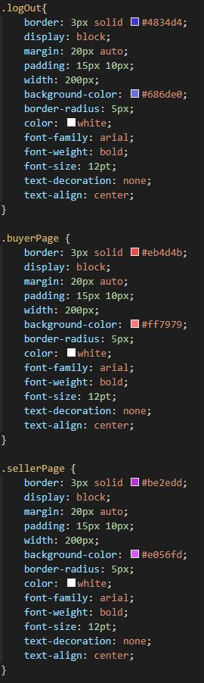
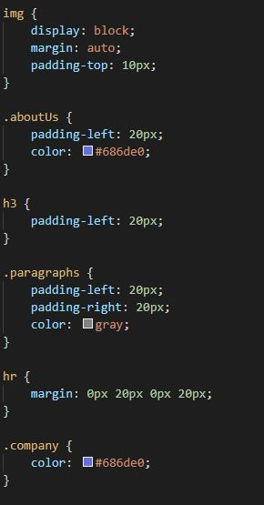

Slide 7
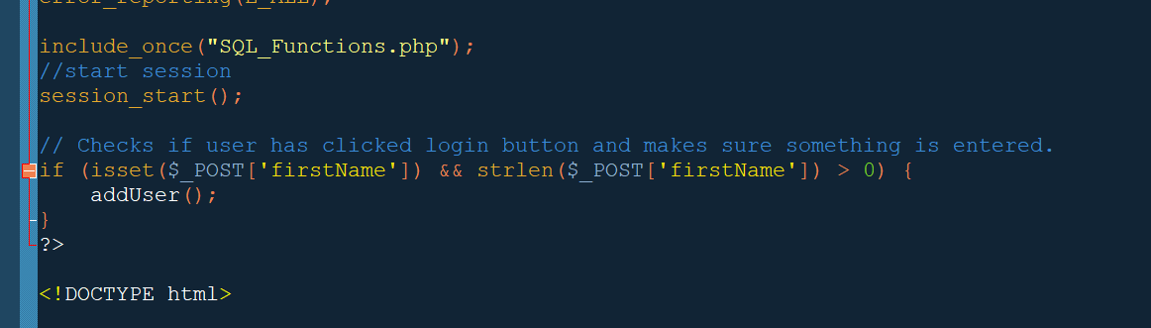
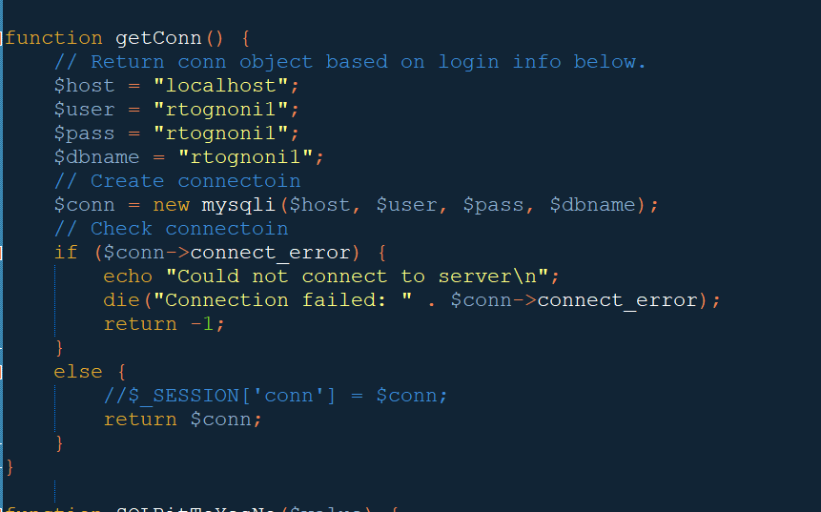
Rob Tognoni (Put work here)
signUp.php

Slide 8
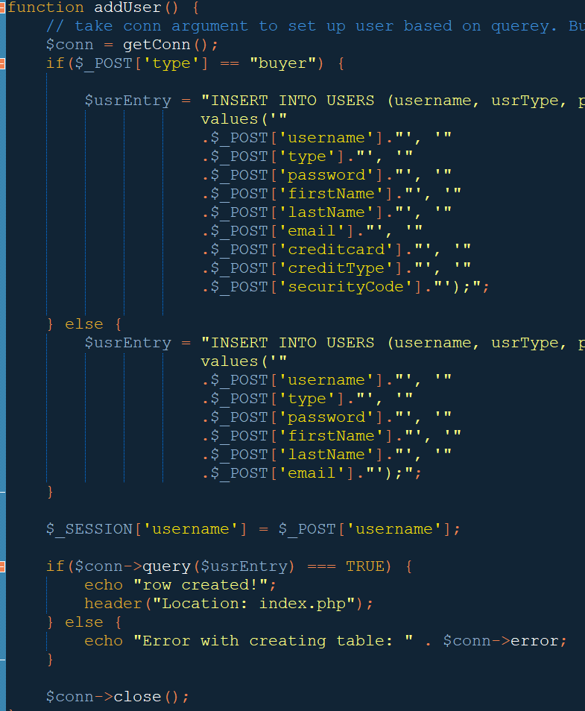
SQL_Functions.php
I didnt figure out that you could insert PHP variables
Into the code without concat yet :(
Generic function to set up connection. Used all over the code.

Slide 9
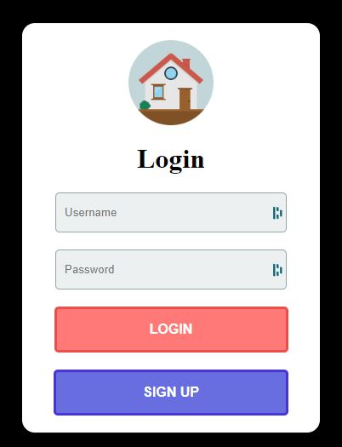
Milestone 2
User Login

Slide 10
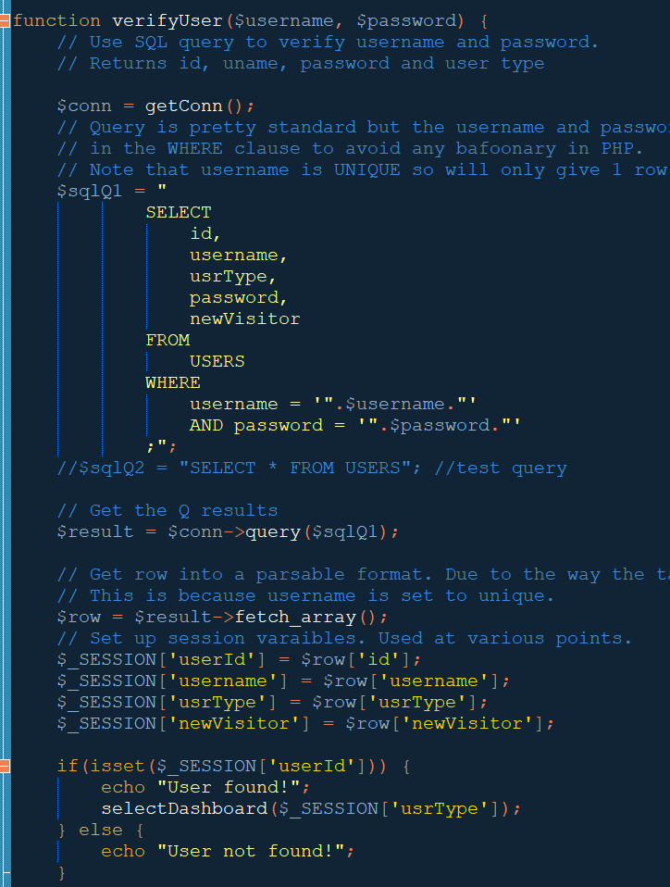
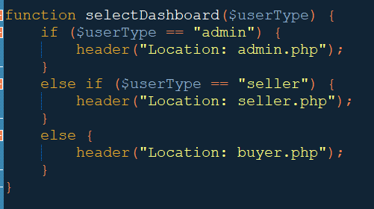
Still using concat :(
The user’s type is saved into session.
This use plugged into a pretty simple switch which
Uses the PHP header() function to change the page.
Validation and data comparison here, and in most
places, in the program is done in the SQL, less often
In PHP

Slide 11
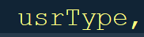
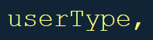
Sadness
This difference cost the project a couple hours. The SQL table still has ‘usrType’ now even though the rest of the code writes out the entire word.
The issue was compounded since when the query was ran the entire page would just turn up blank regardless of what was in it.

Slide 12
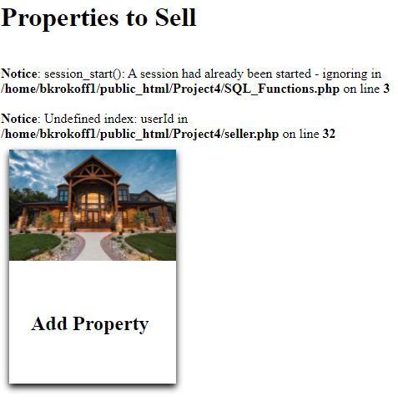
Milestone 3
Seller Dashboard

Slide 13
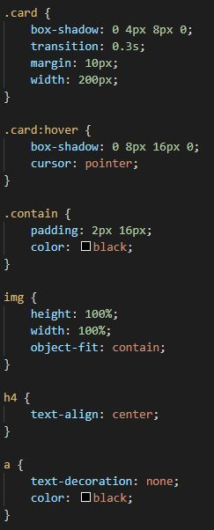
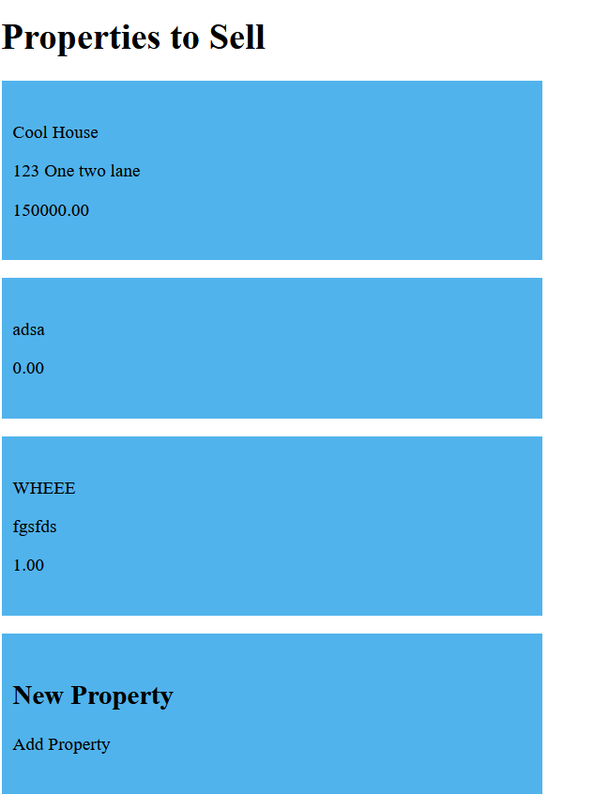
(First working version)

Slide 14
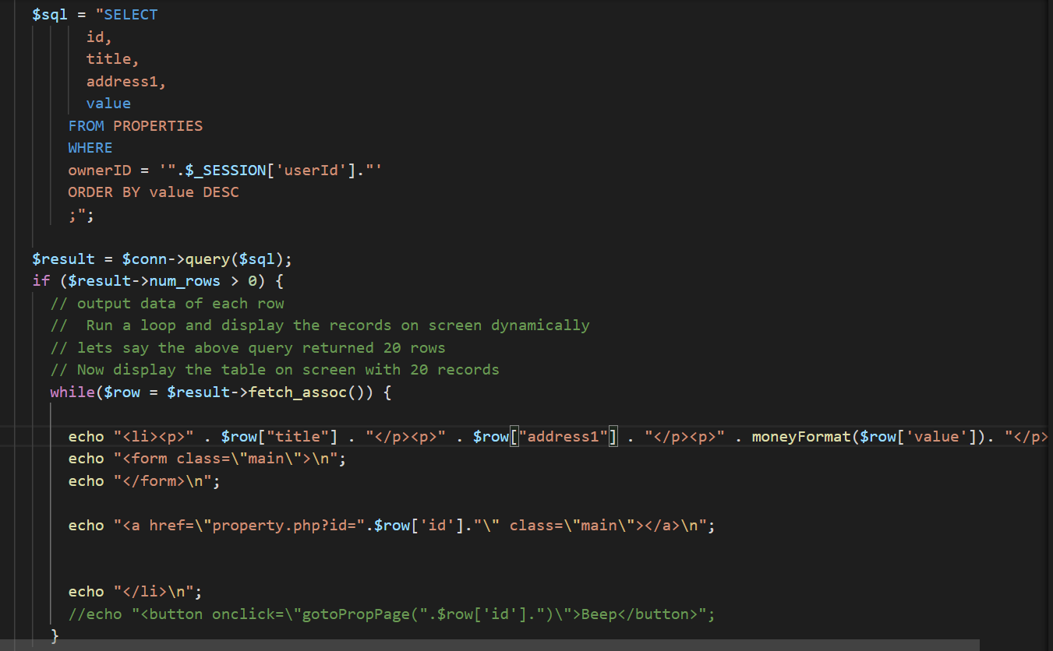
Noah Platt
The page searches for all properties that match the seller ID. It then displays all of those properties in cards defined by CSS.
The page gets the seller ID from the session variables.
There is also a card that is empty that allows users to add a new property.
Each card also includes a link to the property page that passes the property ID.

Slide 15
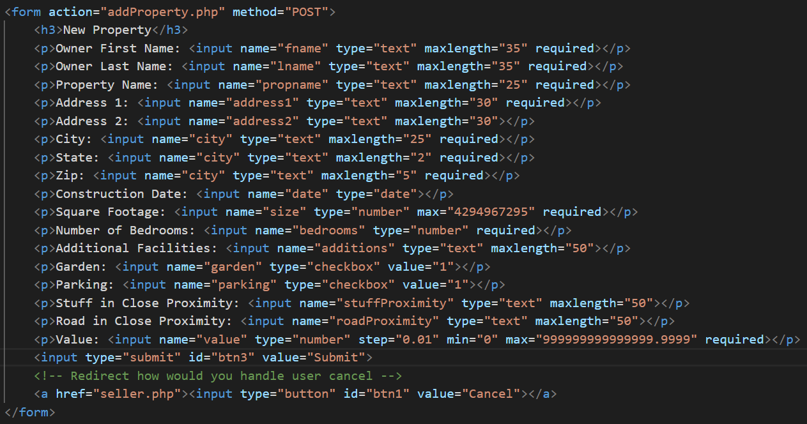
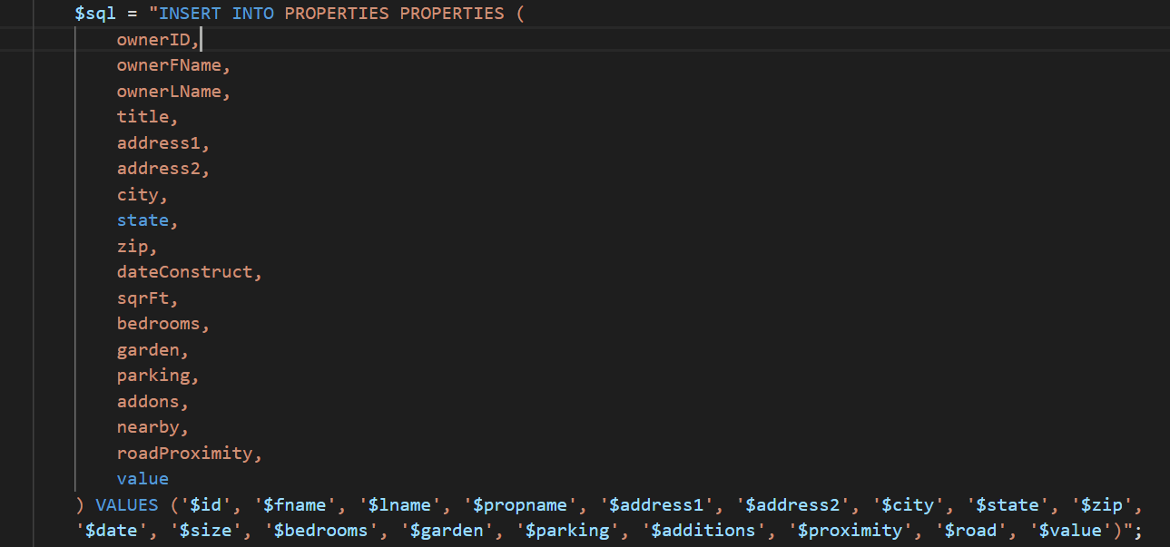
When user clicks empty card, they are directed to a form to create a new property record. The form data is then passed to a php file that reads the data and adds it to the database.

Slide 16
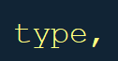
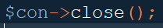
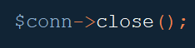
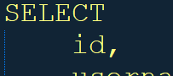
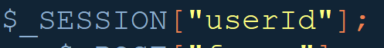
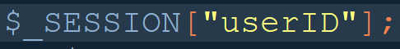
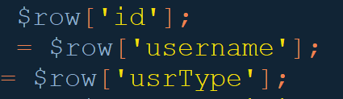
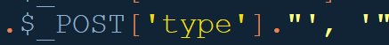
Funtime spot the difference game (diabolical bugs)
Trying to be consistent with variables is more difficult than it sounds.
Especially when the same things like id are thrown around in different contexts, often in parallel.
This is made worse when the lack of SQL snytax checking is added on top of PHPs lackluster error reporting (at least when viewed as a web page).

Slide 17
Milestones (4-6)
Milestone 4 (4/29/22) Buyer Dashboard
Milestone 5 (4/29/22) Admin Dashboard
Milestone 6 (5/2/22) Business Challenges

Slide 18
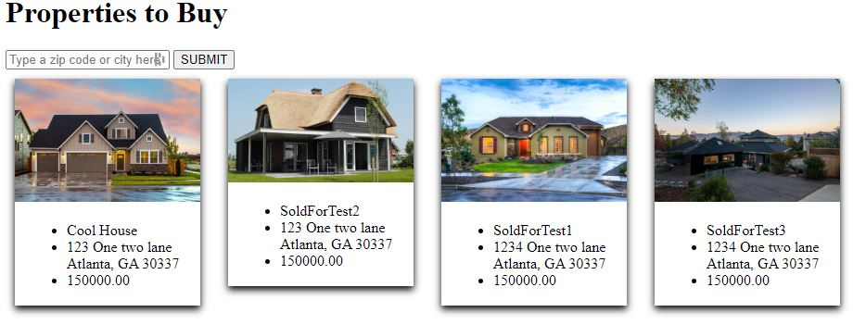
Milestone 4
Buyer Dashboard

Slide 19
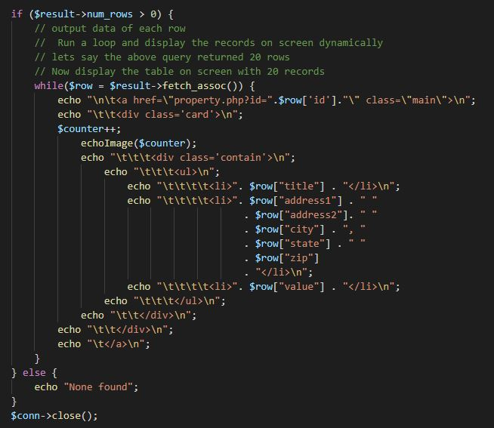
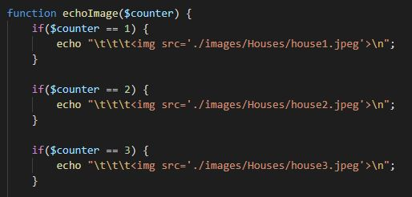
Brett Krokoff (Put work here)

Slide 20
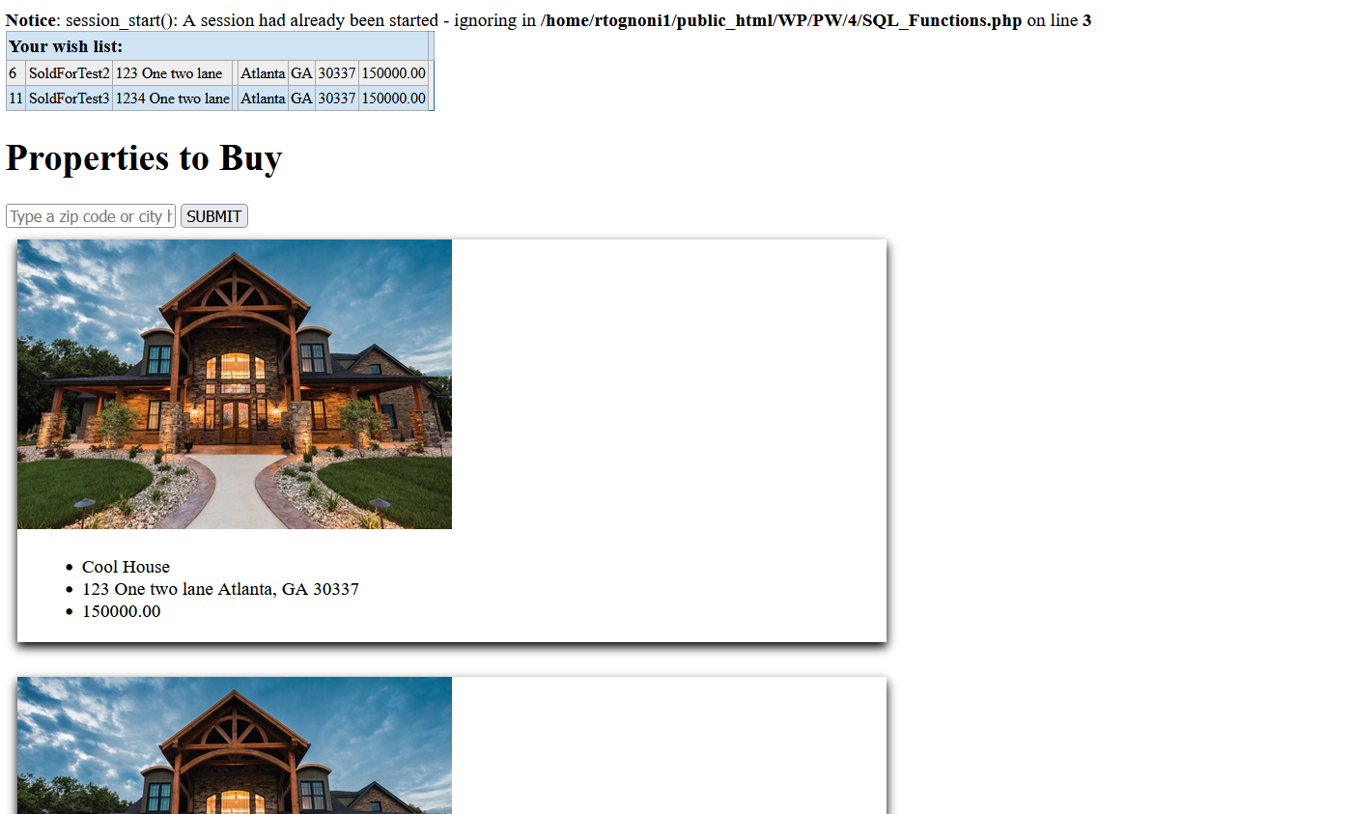
(First working version)

Slide 21
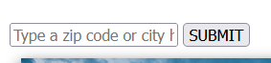
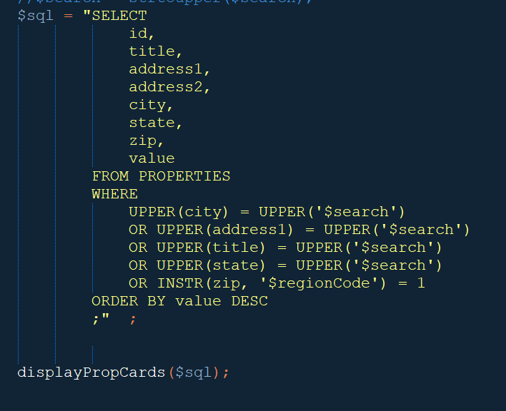
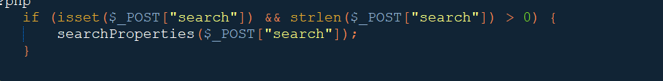
Searching for properties
Most active code for this part of the site is in Buyer_Functions.php.
Search is handled almost entirely with one SQL query. It also handles some input issues by making everything UPPPER.
Everything besides the zipcode is a direct equality search by string.
Zip regions: To some extent the first 3 digits of a zip code are the same for a specific radius around a city (eg. most of Atlanta is 303xx.
In reality it is more complicated than that, but this was a quick way to get some variation on the zip code based search.

Slide 22
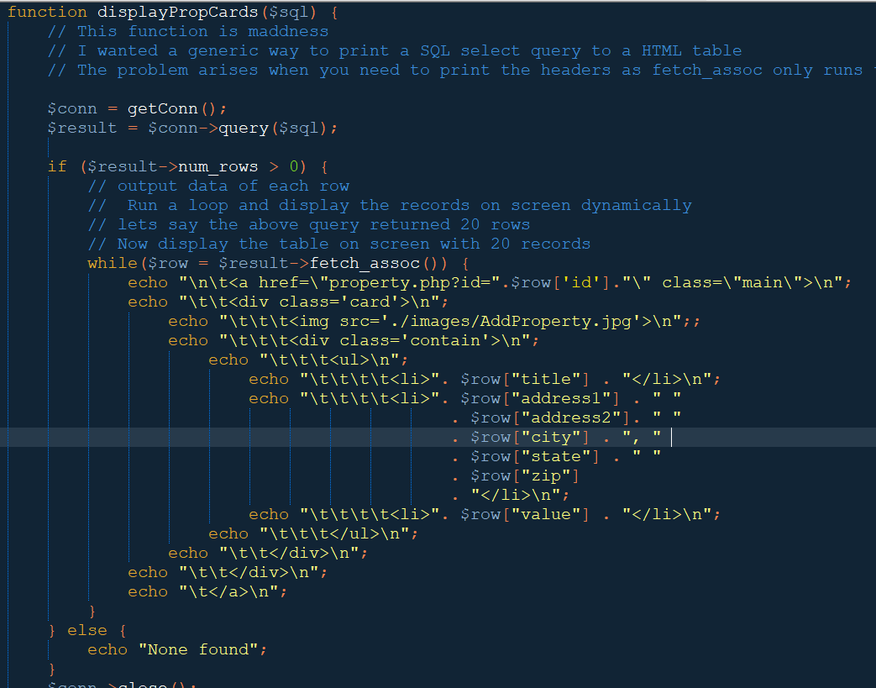
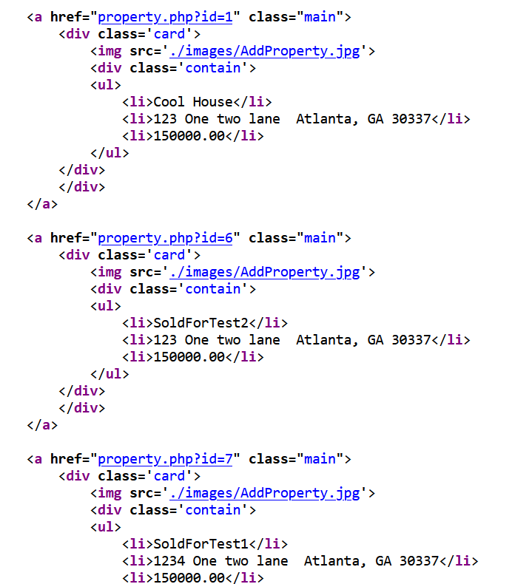
Displaying the search result as cards
Each result row is taken and simply printed as a div structure into html with a list for the property data.
I tried to tab the lines out nicely so it is readable in html, hence the abundance of \t and \n. It isn’t perfect.
The ‘href’ is set to the property.php with the id as a variable making the entire card a link to the property details. This is copied a few times elsewhere.

Slide 23
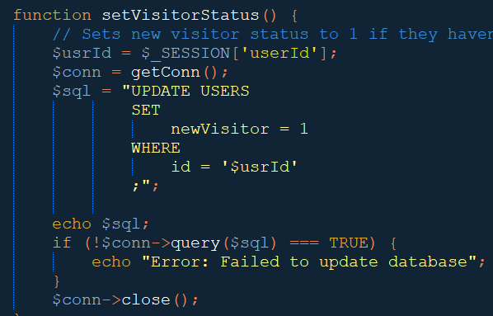
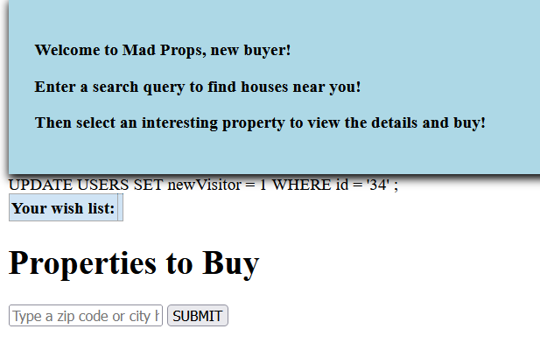
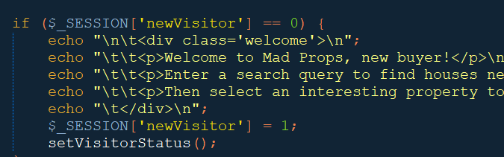
New visitor message
The USERS table has a field that tracks if this is the first time the person has visited the site.
When a user logs in this BIT is saved to $_SESSION and used on this page to trigger (or hide) the new user welcome message.
(Buyer_Functions.php)
(buyer.php)

Slide 24
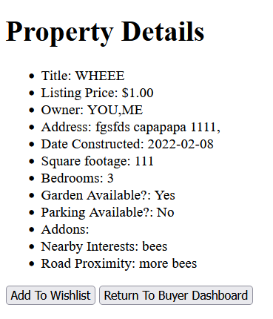
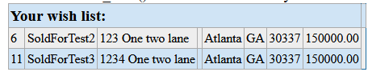
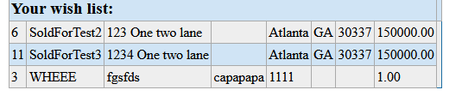
Wish list interactivity
The wishlist is access when a buyer selects a property to view the details (screenshot taken pre-styling).
From here the user can select “Add to Wishlist” which should display a confirmation message. The user can then return to the dashboard to view the results.
Given a bit more time there would be a “remove from wishlist” function. The fields need a bit of work (remove ID).

Slide 25
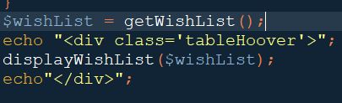
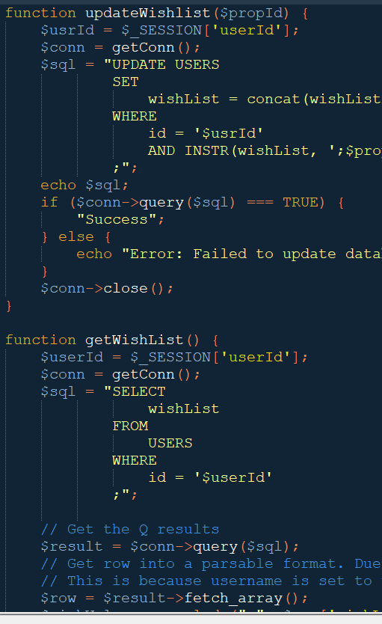
Updating and retrieving the wishlist.
(buyer.php)
The wishlist is saved in the database per user as a single string containing the property IDs that the user selects.
Example: ;6;0;1
Which means the user added pops 6,0 and 1 to their file.
updateWishlist() is run when the user selects a property and clicks “add to wishlist”. This also ensures that there aren’t duplicates in the functions.
getWishList() returns an array of these numbers to be parsed by the display function.
(Buyer_Functions.php)

Slide 26
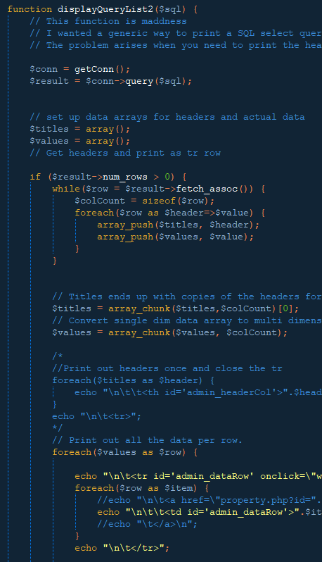
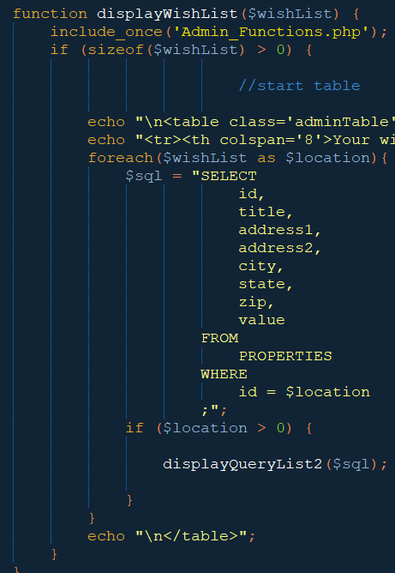
Displaying the wish list
This was done on a time crunch so the display function is a bit of a mess. It is really the table display function from Admin_Functions.php repurposed.
Unfortunately I could not get the query to parse the wish list string correctly so instead I had to modify the function to run for each row of data.
Apologies for the bad code. This for sure needs a re-work.
You can even see fragments of the old admin code where I was setting IDs for CSS and in the comments that are a bit off.

Slide 27
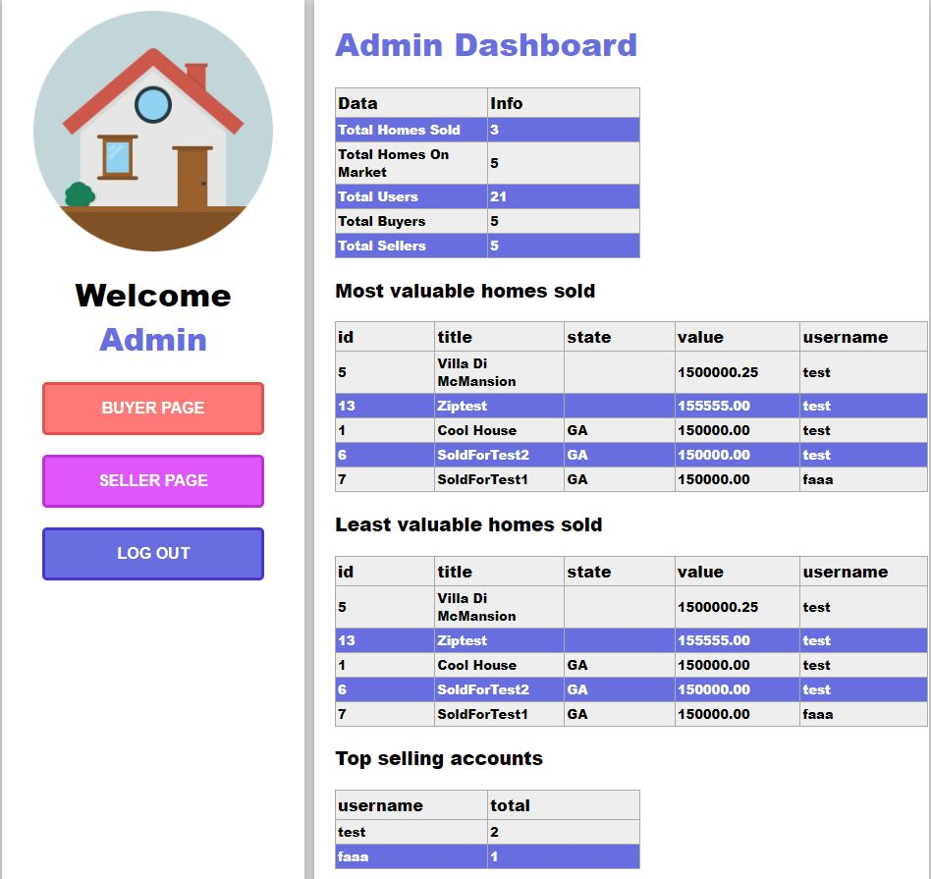
Milestone 5
Admin Dashboard

Slide 28



Slide 29

Tables are all printed with the same function.
This was a bit of a problem since I didn’t want the headers printing for every row
There’s probably a better builtin way to do this, but it works.
Essentially the headers and data are dumped into separate arrays and then those arrays are processed into the tables.
There’s a bit of voodoo getting the table array to be the correct size as it initially will have a copy for every row.
Bug: The tables were later adapted to have each row link to the property they display. This causes redirection to an empty property page.

Slide 30



SQL selections for each table (Admin)
The tables are designed to be sorted by passing ASC or DESC to the function to change them to highest to lowest or lowest to highest. The $number variable controls how many rows are displayed.

Slide 31


First version
Data table: A few general stats.
Bug: As of this screenshot the DB has a bunch of
buyers that are listed as buyer. Instead of just ‘buyer’ which is why there is a discrepancy between the total users and the individual counts. (Fixed by updating the sign up query)
Most valuable/least valuable are just the list of homes sorted by value and in ASC and DESC order.
The top selling accounts table takes a count of users and how many homes they have listed as “sold” in the db
Right now there isn’t a way to buy a house on the site, so these were set up manually in SQL.

Slide 32




Things we couldn’t get to:
The option to buy a property is not complete. The info in the tables is there and the admin dash will reference it however.
The form validation on user signup is minimal. Emails, numbers etc will pretty much take any information.
Property images - currently it just displays a stock image. The code to do this isn’t that difficult (post image to folder, save location in SQL etc etc).
More interactivity - A few pages don’t give enough feedback when the user either inputs data or clicks certain buttons. Ideally there would be popups or animations that guide the user.
Initially was going to have the user’s login name auto-fill when the moved to the index page from the sign up page.

Slide 33

Overall Design document

Slide 34

Work checklist

Slide 35

SQL Table Design

Slide 36

Demo
Thank you for your time!

